Slide 1
May 2022 Planning Commission Meeting
Agenda Item No. 3
Design Review Application – 18181 WEBSTER RD

Slide 2
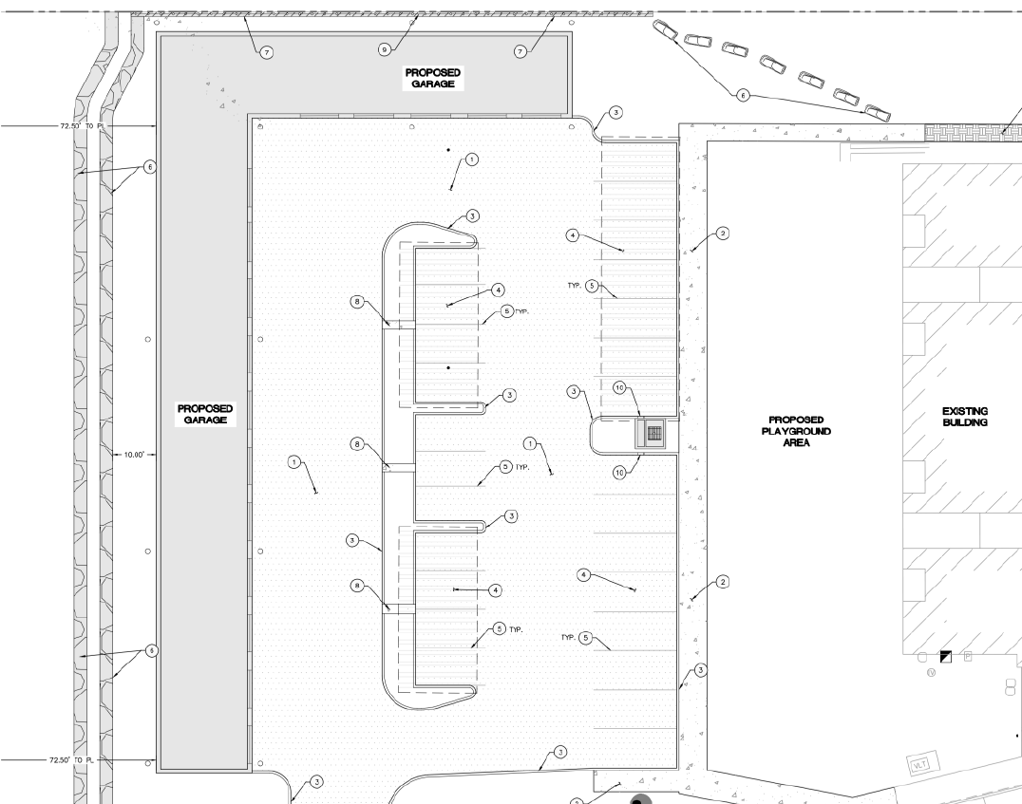
Public Hearing
Project overview
Previous approvals
Design Review
Key Findings
Next steps
May 17, 2022 Z0024-22-D

Slide 3
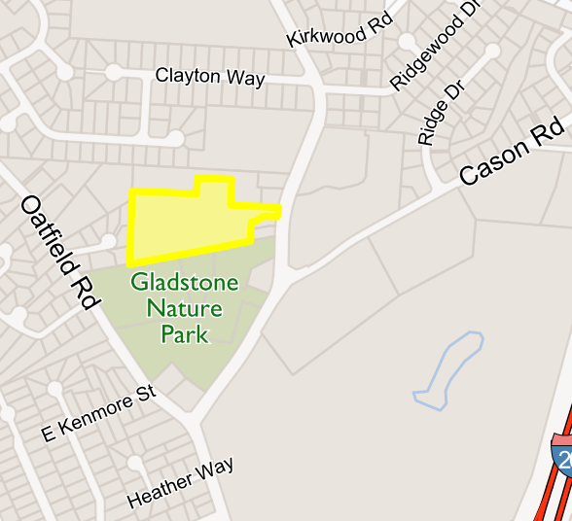
Project Location: 18181 WEBSTER RD
Proposed Project: Construction of new parking garages, and playground to serve the Webster Ridge Apartments. As proposed, the development will include 16 parking garages, 26 parking spaces, and 4,000 square feet of landscaping with walking paths and a play area.
May 17, 2022 Z0024-22-D

Slide 4
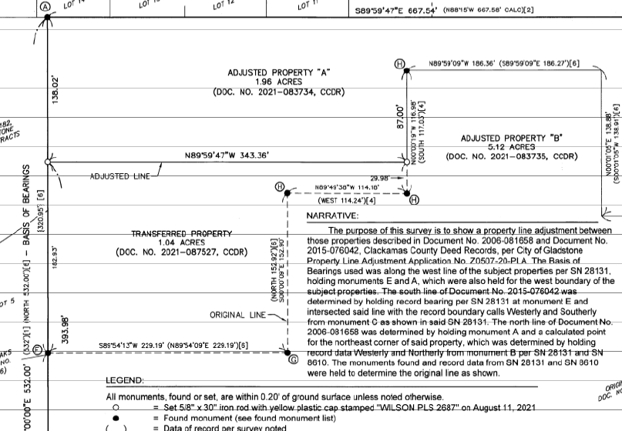
Previous Land Use Approvals:
Apartments: Z0249-15
Zone Change: Z0149-20
Property Line Adjustment: Z0507-20
Future Use. The 1.04 acres that are to be rezoned shall be developed expressly with land uses customarily considered accessory to Multifamily residences per 17.14.030 in addition to recreational uses per 17.68.040.
May 17, 2022 Z0024-22-D

Slide 5
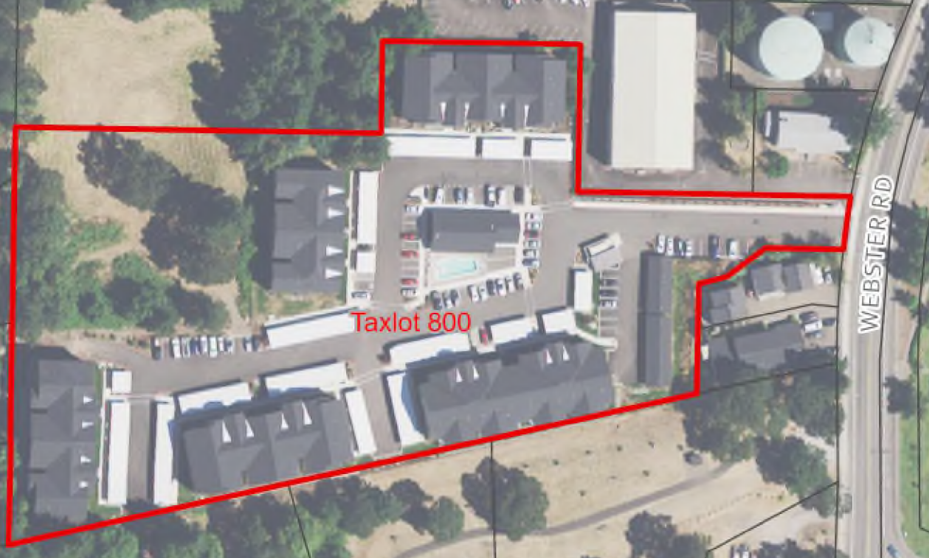
Project Site
Zoning Designation: MR
Comprehensive Plan Designation: Multifamily Residential
Property size: 5.12 acres
Property is not subject to any environmental overlays
Proposed Site
May 17, 2022 Z0024-22-D

Slide 6
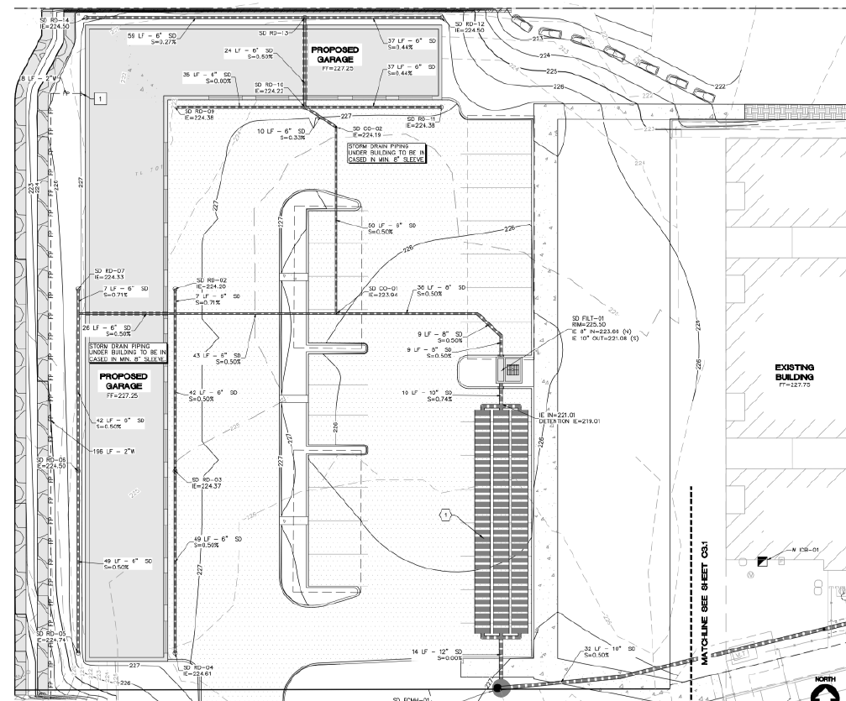
Public Noticing:
Sent to the applicant, the owner of the subject property and owners of record as identified on the most recent Clackamas County property tax assessment roll of property located within two hundred fifty (250) feet of the subject property.
City of Gladstone, Public Works, Gladstone Fire, Gladstone PD, Engineering, WES
Comments Received:
Public Works, and Engineering provided joint comments, WES, and Fire provided comments.
May 17, 2022 Z0024-22-D

Slide 7
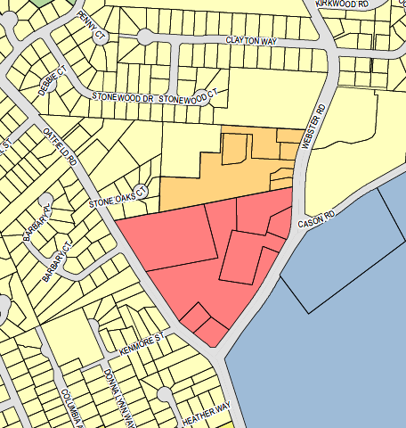
Current Zoning Map-
Excerpt showing MR
Zoning District along Webster Rd
Subject Property
May 17, 2022 Z0024-22-D

Slide 8
Section 17.14.020
Uses allowed outright
(1) Buildings. Garages and carports, storage and other buildings,
May 17, 2022 Z0024-22-D

Slide 9
Section 17.18.060 Dimensional standards.
(17.14.050 Dimensional standards.
(1) Lot area:
(b) For a two-family or multi-family dwelling, the minimum lot area shall be three thousand square (3,000) feet plus one thousand (1,000) square feet per dwelling unit;
(2) Setback Requirements:
(a) A front setback shall be a minimum of twenty feet (20’);
(b) A side setback shall be a minimum of five feet (5’);
(c) A rear setback shall be a minimum of fifteen feet (15’);
(d) A street side setback shall be a minimum of twenty feet (20’);
(e) Architectural features such as cornices, eaves, gutters, chimneys and flues may project a maximum of two feet (2’) into a required setback area;
The subject property is 5.12 acres in size. Webster Road is the front of the property with the western boundary as the rear and the north and south property boundaries as the side.
May 17, 2022 Z0024-22-D

Slide 10
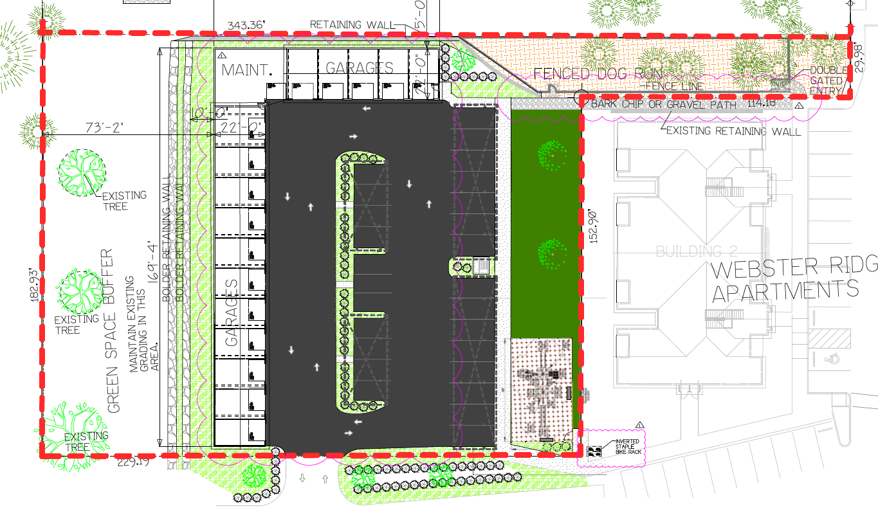
Section 17.18.060 Dimensional standards.
(3) Building Height. The maximum building height shall be thirty-five feet (35’).
(4) Minimum Vegetation. The minimum area that must be left or planted in trees, shrubs, grass, etc., shall be at least twenty percent (20%) of the total area of the lot.
May 17, 2022 Z0024-22-D

Slide 11
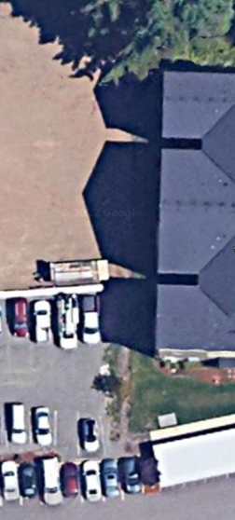
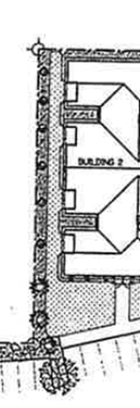
Special Condition #1 Landscaping.
Z0249-15 approved/
required shrubs and perennials in addition to lawn
2020 CONNECTExplorer aerial 2022 Google Aerial 2015 Landscape plan.
May 17, 2022 Z0024-22-D

Slide 12
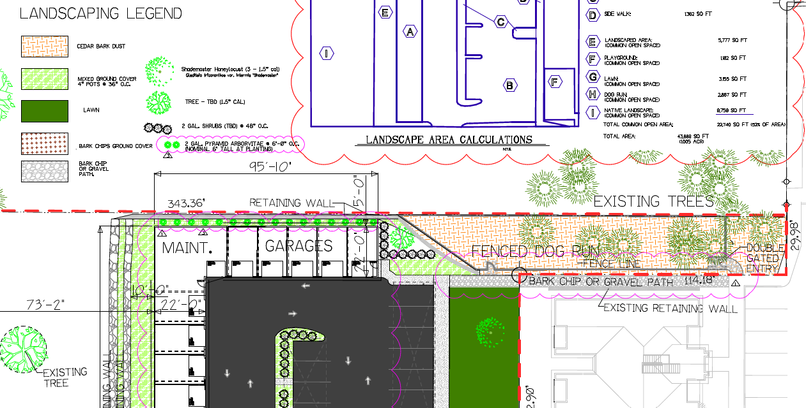
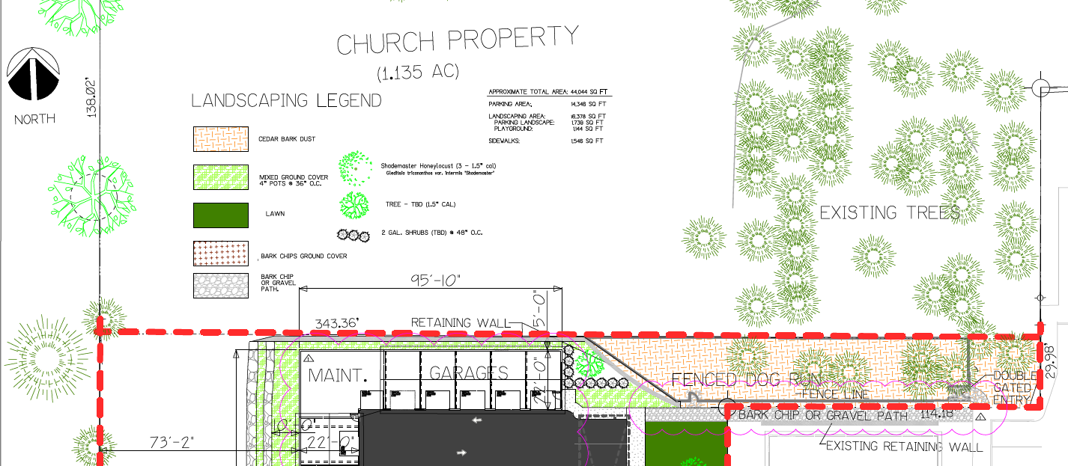
Special Condition #1 Landscaping.
Revised 4/1/22 to include calculations
Revised 5/16/22 to include site obscuring landscaping
May 17, 2022 Z0024-22-D

Slide 13
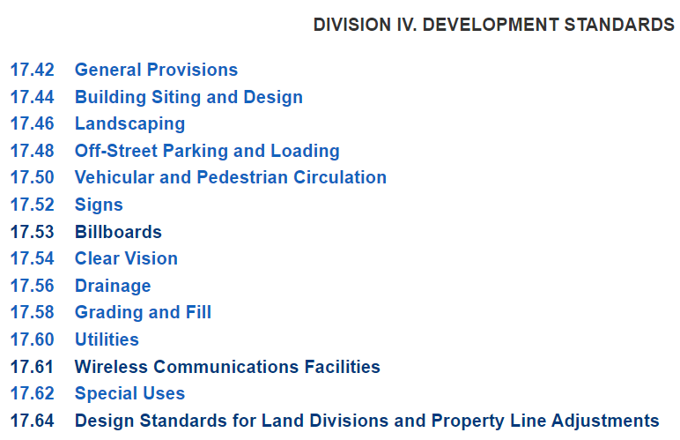
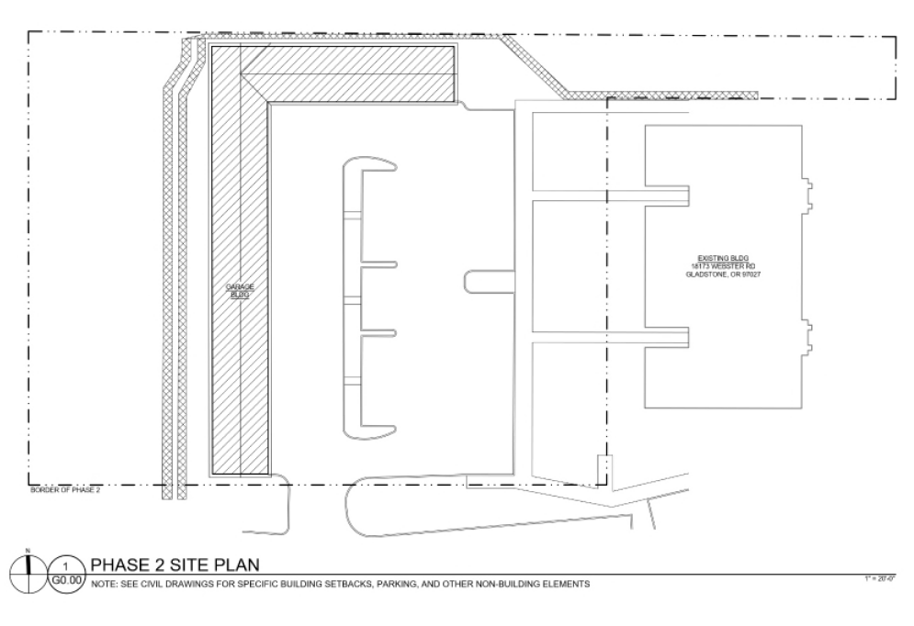
Section 17.80 DESIGN REVIEW
May 17, 2022 Z0024-22-D

Slide 14
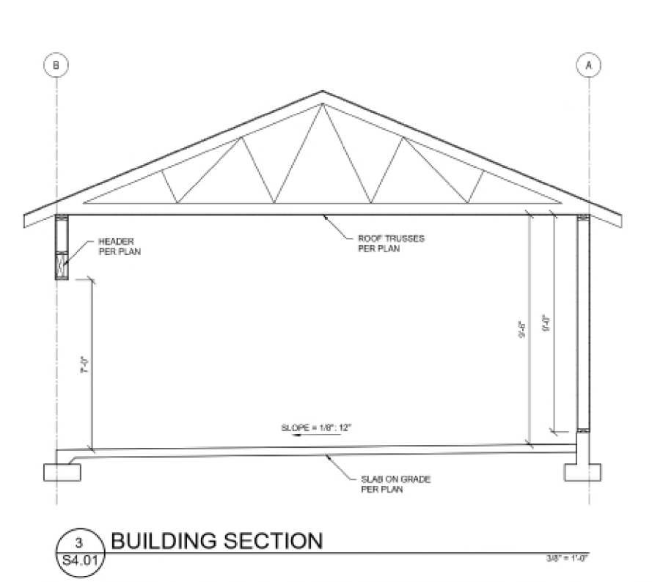
Section 17.44.020 Building Siting and Design
Siting.
Energy Efficient Design.
Compatibility.
Building Materials.
Buildings shall be constructed using high-image exterior materials and finishes such as masonry, architecturally treated tilt-up concrete, glass, wood or stucco. Buildings shall not be constructed with metal siding material, except as approved by the design review committee for specific high-image materials, except for:
(a) Canopies, awnings, screening for roof-mounted fixtures, or other architectural features:
(b) Utility equipment cabinets:
(c) Structures no greater than two hundred (200) square feet in floor area and ten (10) feet in height: and,
(d) Buildings, the portions of buildings, that are not visible from a road or adjacent property.
May 17, 2022 Z0024-22-D

Slide 15
Section 17.44.022 Multi-family Design Standards
New multi-family buildings, including accessory buildings, shall be subject to the following design standards:
(1) Façades. Building façades and exterior walls visible from a public street or pedestrian path or from adjacent property in an R-5 or R-7.2 zoning district shall not consist of a monotonous blank wall and shall include a minimum of two of the following:
(a) Windows;
(b) Entries;
(c) Balconies;
(d) Bays; or
(e) The use of two or more distinct materials to break up stretches longer than fifty lineal feet (50’) of unbroken area.
(2) Windows.
(a) Window trim shall not be flush with exterior wall treatment.
(b) Windows shall be provided with an architectural surround at the jamb, head and sill.
(c) All windows facing the front lot line shall be double hung or casement windows.
(3) Roofs. Hipped, gambrel or gabled roofs shall be required. Flat roofs shall not be permitted except in areas where mechanical equipment is mounted.
May 17, 2022 Z0024-22-D

Slide 16
Special Condition #3 Building façade.
17.44.022 applies. The proposed garages are adjacent to low density residential property to the north and west. Therefore, the north wall of the parking garages that measures over 95 feet long shall be modified to include a minimum of two of the following: (a) Windows; (b) Entries; (c) Balconies; (d) Bays; or (e) The use of two or more distinct materials to break up stretches longer than fifty lineal feet (50’) of unbroken area.
Received 5/17/22
May 17, 2022 Z0024-22-D

Slide 17
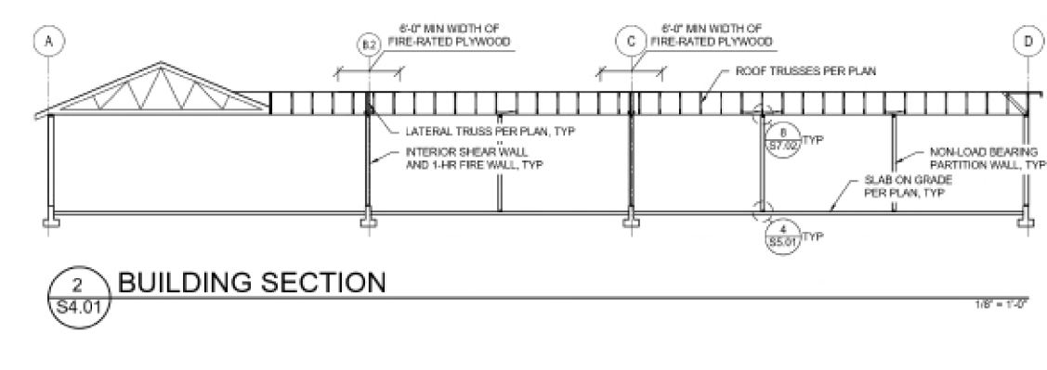
Section 17.44.020 Building Siting and Design
(5) Lighting. Adequate exterior lighting shall be provided to protect public safety and shall be deflected so as not to shine on a lot in a residential district.
(6) On-site Lighting. All on-site lighting shall be designed, located, shielded, or deflected so as not to shine into off-site structures or impair the vision of the driver of any vehicle. When required, engineered site lighting plans shall be developed consistent with Illuminating Engineering Standards (IES) including, but not limited to, average maintained illumination and maximum to minimum ratios. A master plan for on-site lighting shall include the design, height, and location of all proposed exterior lights, including:
(a) Parking and loading area lighting;
(b) Pedestrian walkway lighting;
(c) Internal access road lighting;
(d) Lighting of public entrances into buildings;
(e) Flood lights illuminating buildings or significant natural features.
May 17, 2022 Z0024-22-D

Slide 18
Z0024-22 Potential Special Condition #4 Lighting.
4. A photometric analysis and lighting plan, or a master plan for on-site lighting, that includes the design, height, extent, and location of all proposed exterior lights per 17.44.020 (6).
Z0149-20 Special Condition #2
2. Lighting. The future development of the site shall provide limited lighting per 17.44.020(5) and (6). Any lighting installed shall be the minimum amount required to meet the City of Gladstone Public Works requirements.
May 17, 2022 Z0024-22-D

Slide 19
Z0024-22 Potential Special Condition #4 Lighting.
4. A photometric analysis and lighting plan, or a master plan for on-site lighting, that includes the design, height, extent, and location of all proposed exterior lights per 17.44.020 (6).
Z0149-20 Special Condition #2
2. Lighting. The future development of the site shall provide limited lighting per 17.44.020(5) and (6). Any lighting installed shall be the minimum amount required to meet the City of Gladstone Public Works requirements.
May 17, 2022 Z0024-22-D

Slide 20
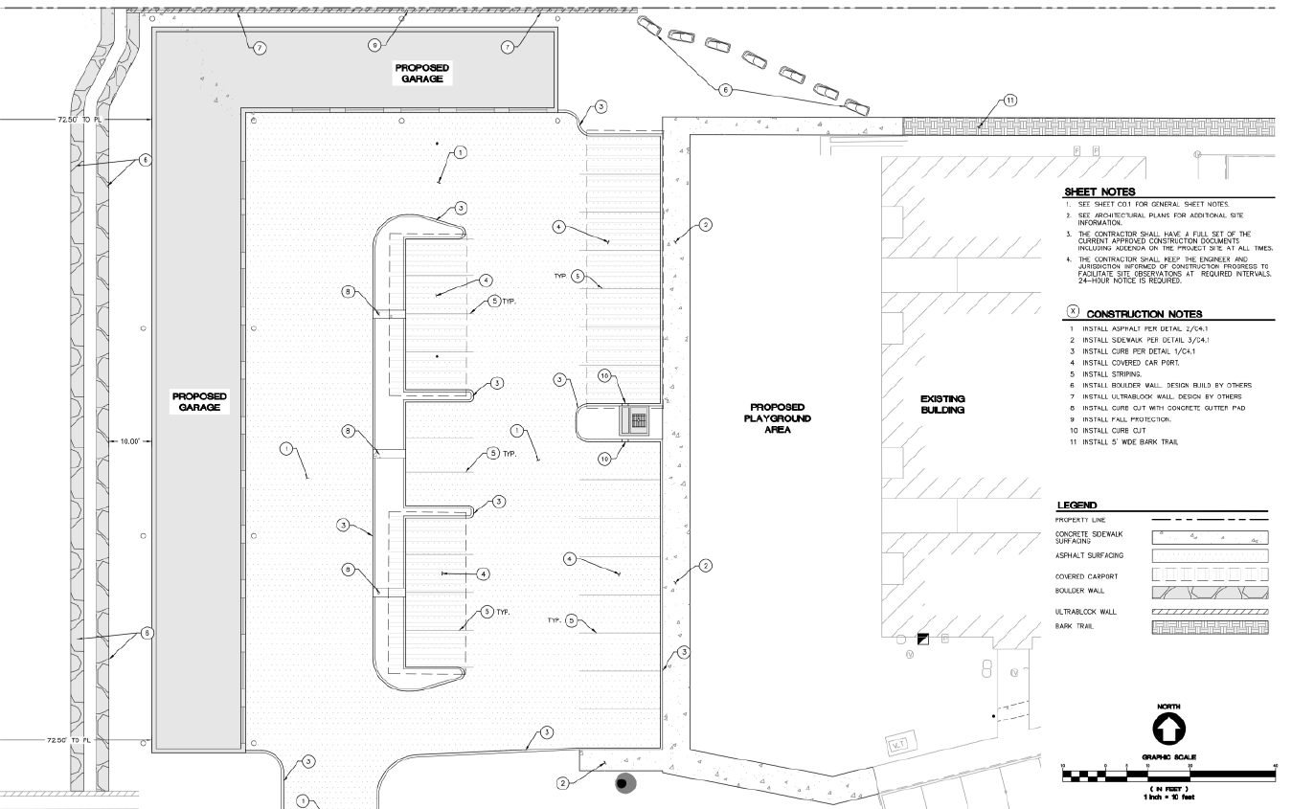
Z0024-22 Potential Special Condition #5 & #6 ADA and Pedestrian Access.
17.50.020 Vehicular and pedestrian circulation generally.
(5) Handicapped Needs. Provide for the special needs of the handicapped such as wheelchair ramps and Braille signs.
(6) Pedestrian Circulation Standards. An on-site pedestrian circulation system shall be provided for new nonresidential and multi-family developments and for new buildings added to existing nonresidential and multi-family developments. The system may include sidewalks as part of the public rights-of-way, walkways, and multi-use paths. (Walkways only provide for pedestrian circulation; multi-use pathways accommodate pedestrians and bicycles.) The system shall comply with the following standards:
May 17, 2022 Z0024-22-D

Slide 21
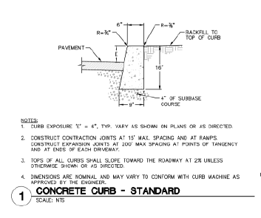
Z0024-22 Potential Special Condition #5 & #6 ADA and Pedestrian Access.
(6) Pedestrian Circulation Standards…… shall comply with the following standards:
(a) The system shall connect all adjacent streets to the main entrances of nonresidential buildings and to unit and/or building entrances of multi-family developments;
(b) The system shall connect all buildings and other areas of the site, such as parking areas, bicycle parking, recreational areas, common outdoor areas and any pedestrian amenities;
(c) The system shall be hard-surfaced and constructed in accordance with the public works standards. For nonresidential development, the walkways shall be a minimum of six feet wide. For multi-family residential development, walkways shall be a minimum of five feet wide;
(d) The system and off-street parking and loading areas shall be designed to avoid, to the maximum extent possible, the system’s crossing off-street parking and loading areas. Where the system crosses driveways or off-street parking and loading areas, the system shall be clearly identifiable through the use of elevation changes, speed bumps, a different paving material or other similar method. Striping shall not fulfill this requirement;
(e) Where the system is parallel and adjacent to an auto travel lane, the system shall be a raised path or be separated from the auto travel lane by a raised curb, bollards, landscaping or other physical barrier. If a raised path is used, the ends of the raised portions shall be equipped with curb ramps;
(f) The system shall comply with the Americans with Disabilities Act (ADA);
May 17, 2022 Z0024-22-D

Slide 22
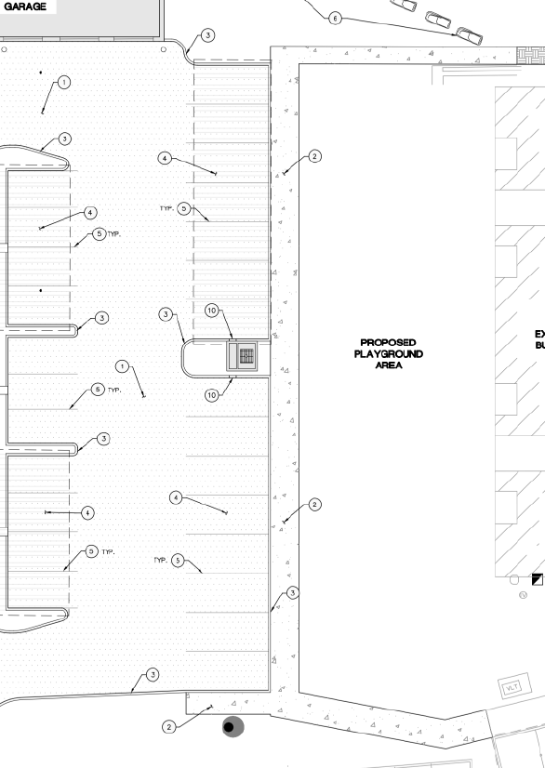
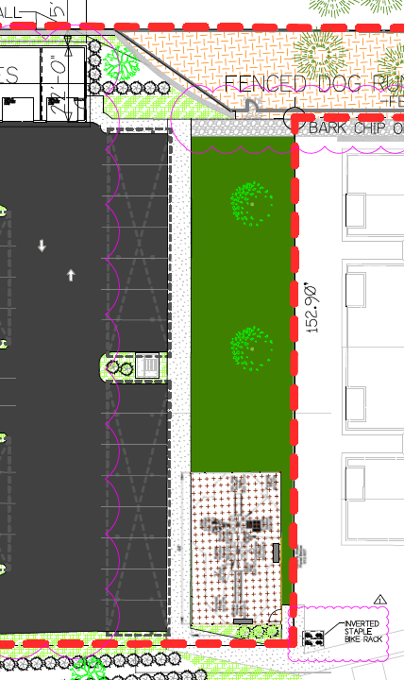
Z0024-22 Potential Special Condition #5 & #6 ADA and Pedestrian Access.
Sidewalks and pedestrian access plans need to be uniform and provide access to amenities including Garages, playground, parking spaces
May 17, 2022 Z0024-22-D

Slide 23
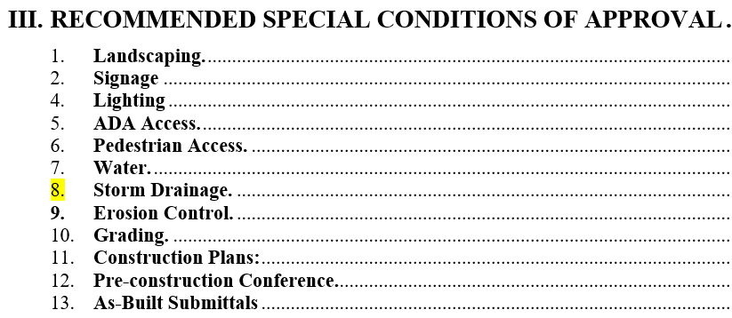
RECOMMENDATION
The Gladstone Planning Staff are recommending Approval of the Design Review application, with 13 Special Conditions of approval.
May 17, 2022 Z0024-22-D

