Slide 1
October 2022, Planning Commission Meeting
Agenda Item No. 4
TXT-2022-03 Options

Slide 2
Planning Commission Public Hearing
Options for Manufactured Homes
Options for Middle Housing Land Divisions
10/18/22 TXT-2022-03

Slide 3
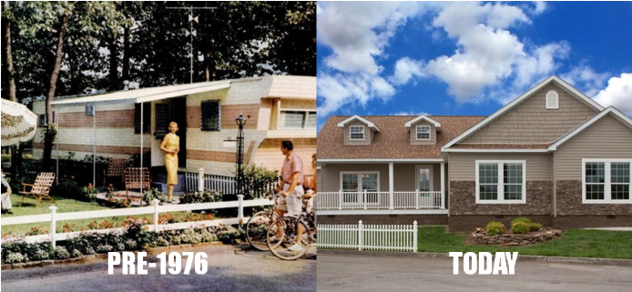
HB 4064 [2022] Manufactured Dwellings -
HB 4064 [2022] prohibits cities from regulating manufactured dwellings in a manner that is inconsistent with detached single family dwellings. “A local government may not subject manufactured homes or prefabricated structures within an urban growth boundary, or the land upon which the homes or structures are sited, to any applicable standard that would not apply to a detached, site-built single-family dwelling on the same land, except: (a) As necessary to comply with a protective measure adopted pursuant to a statewide land use planning goal; or (b) To require that the manufacturer certify that the manufactured home or prefabricated structure has an exterior thermal envelope meeting performance standards which reduce levels equivalent to the performance standards required of single-family dwellings constructed under the Low-Rise Residential Dwelling Code as defined in ORS 455.010.”
Image Source: HUD - https://www.hud.gov/OMHP
10/18/22 TXT-2022-03

Slide 4
17.06.328 Manufactured dwelling.
“Manufactured dwelling” is a dwelling that meets either of the following:
1. A structure constructed for movement on the public highways that has sleeping, cooking and plumbing facilities, that is intended for human occupancy, that is being used for residential purposes and that was constructed in accordance with federal manufactured housing construction and safety standards and regulations in effect at the time of construction; or
2. A building or subassembly that has been in whole or substantial part manufactured or assembled using closed construction at an off-site location to be wholly or partially assembled on-site, and that is relocatable, more than eight and one-half feet wide and designed for use as a single-family dwelling.
“Manufactured dwelling” means a single household dwelling with a Department of Housing and Urban Development (HUD) label certifying that the structure was constructed on or after June 15, 1976, and met the requirements of the Federal Manufactured Housing Construction and Safety Standards and Regulations in effect at the time of construction, consistent with 1989 Oregon Laws, Chapter 380, 1989. This definition shall not apply to structures known as “modular homes” where such modular homes are constructed in accordance with all requirements of the state building code for modular homes and bear the Seal of Approval of the State of Oregon,
10/18/22 TXT-2022-03

Slide 5
17.10.060 and 17.12.060- Current
(4) Manufactured Dwellings. All manufactured dwellings on individual lots in this district shall meet or exceed the following design standards:
(a) The manufactured dwelling shall be multi-sectional and enclose a space of not less than 1,000 square feet;
(b) The manufactured dwelling shall be placed on an excavated, backfilled foundation and enclosed at the perimeter such that no more than 12 inches of the enclosing material is exposed above grade. Where the building site has a sloped grade, no more than 12 inches of the enclosing material shall be exposed on the uphill side of the home. If the manufactured dwelling is placed on a basement, the 12-inch limitation shall not apply;
(c) The manufactured dwelling shall have a pitched roof of not less than three feet in height for each twelve feet in width;
(d) The manufactured dwelling shall have exterior siding and roofing which in color, material and appearance is similar to the exterior siding and roofing material on surrounding dwellings;
(e) The manufactured dwelling shall be certified by the manufacturer to have an exterior thermal envelope meeting performance standards equivalent to the performance standards required of single-family dwellings constructed under the Oregon Residential Specialty Code. Evidence demonstrating that the manufactured home meets “Super Good Cents” energy efficiency standards is deemed to satisfy the exterior thermal envelope certification standards. Additional manufacturer’s certification shall not be required in such cases.
(f) The manufactured dwelling shall have a garage or carport constructed of like materials. An attached or detached garage may be approved in lieu of a carport where such is consistent with the predominant construction of immediately surrounding dwellings.
10/18/22 TXT-2022-03

Slide 6
Option A – Remove Sections 17.10.060 and 17.12.060 Entirely
(4) Manufactured Dwellings. All manufactured dwellings on individual lots in this district shall meet or exceed the following design standards:
(a) The manufactured dwelling shall be multi-sectional and enclose a space of not less than 1,000 square feet;
(b) The manufactured dwelling shall be placed on an excavated, backfilled foundation and enclosed at the perimeter such that no more than 12 inches of the enclosing material is exposed above grade. Where the building site has a sloped grade, no more than 12 inches of the enclosing material shall be exposed on the uphill side of the home. If the manufactured dwelling is placed on a basement, the 12-inch limitation shall not apply;
(c) The manufactured dwelling shall have a pitched roof of not less than three feet in height for each twelve feet in width;
(d) The manufactured dwelling shall have exterior siding and roofing which in color, material and appearance is similar to the exterior siding and roofing material on surrounding dwellings;
(e) The manufactured dwelling shall be certified by the manufacturer to have an exterior thermal envelope meeting performance standards equivalent to the performance standards required of single-family dwellings constructed under the Oregon Residential Specialty Code. Evidence demonstrating that the manufactured home meets “Super Good Cents” energy efficiency standards is deemed to satisfy the exterior thermal envelope certification standards. Additional manufacturer’s certification shall not be required in such cases.
(f) The manufactured dwelling shall have a garage or carport constructed of like materials. An attached or detached garage may be approved in lieu of a carport where such is consistent with the predominant construction of immediately surrounding dwellings.
10/18/22 TXT-2022-03

Slide 7
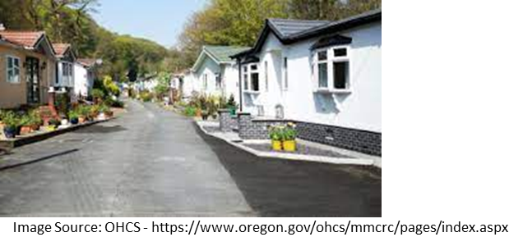
Option B – Modify 17.10.060 and 17.12.060- Potential Amendments
(3) Design Features. Single-family dwellings shall include at least two four of the following design features:
(a) Dormer;
(b) One or more windows that face the street lot line;
(c) Cupola;
(d) Bay or bow window;
(e) Gable;
(f) Covered porch entry;
(g) Eaves (minimum six 12inches projection); and
(h) Offset on building face or roof (minimum 16 inches).;
(i) Roof pitch of not less than three feet in height for each twelve feet in width; and
(j) Garage or carport. The garage or carport can be attached (see 17.12.060(1)) or detached.
10/18/22 TXT-2022-03

Slide 8
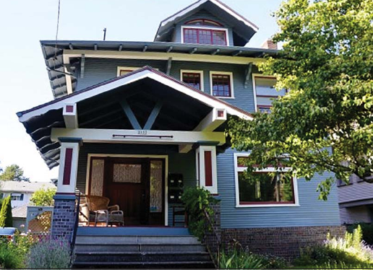
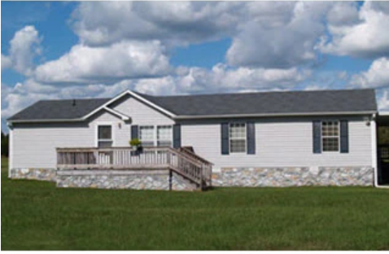
17.10.060 and 17.12.060- Potential Amendments Continued:
(3) Foundations shall meet the following design standards:
The dwelling shall be placed on an excavated, backfilled foundation and enclosed at the perimeter such that no more than 12 inches of the enclosing material is exposed above grade; and
Where the building site has a sloped grade, no more than 12 inches of the enclosing material shall be exposed on the uphill side of the home; and
If the dwelling sits on a basement, the 12-inch limitation shall not apply.
Image Source: Census - https://www.census.gov/programs-surveys/mhs.html
10/18/22 TXT-2022-03

Slide 9
17.10 and 17.12.060-Potential Amendments Continued
(4) Manufactured Dwellings. All manufactured dwellings on individual lots in this district shall meet or exceed the following design standards:
(a) The manufactured dwelling shall be multi-sectional and enclose a space of not less than 1,000 square feet;
(b) The manufactured dwelling shall be placed on an excavated, backfilled foundation and enclosed at the perimeter such that no more than 12 inches of the enclosing material is exposed above grade. Where the building site has a sloped grade, no more than 12 inches of the enclosing material shall be exposed on the uphill side of the home. If the manufactured dwelling is placed on a basement, the 12-inch limitation shall not apply;
(c) The manufactured dwelling shall have a pitched roof of not less than three feet in height for each twelve feet in width;
(d) The manufactured dwelling shall have exterior siding and roofing which in color, material and appearance is similar to the exterior siding and roofing material on surrounding dwellings;
(e) The manufactured dwelling shall be certified by the manufacturer to have an exterior thermal envelope meeting performance standards equivalent to the performance standards required of single-family dwellings constructed under the Oregon Residential Specialty Code. Evidence demonstrating that the manufactured home meets “Super Good Cents” energy efficiency standards is deemed to satisfy the exterior thermal envelope certification standards. Additional manufacturer’s certification shall not be required in such cases.
(f) The manufactured dwelling shall have a garage or carport constructed of like materials. An attached or detached garage may be approved in lieu of a carport where such is consistent with the predominant construction of immediately surrounding dwellings.
10/18/22 TXT-2022-03

Slide 10
STAFF RECOMMENDATION:
Gladstone Planning Commission recommends the City Council consider and adopt the amendments related to Manufactured Homes to be consistent with the requirements for site built homes in response to HB 4064.
10/18/22 TXT-2022-03

Slide 11
17.06 Amendments-
17.06.231 Household. - amended location for consistency with the alphabet.
17.06.330 Middle housing land division.
The partition or subdivision of a lot of record that is developed, or proposed to be developed, with middle housing dwelling units. The type of middle housing developed on the original lot of record is not altered by a middle housing land division. Middle housing land divisions are expedited land divisions that are subject to the process outlined in ORS 197.375.
10/18/22 TXT-2022-03

Slide 12
SB 4064 [2021] Expedited or Middle Housing Land Divisions-
(2) A city or county shall approve a tentative plan for a middle housing land division if
the application includes:
(a) A proposal for development of middle housing in compliance with the Oregon residential
specialty code and land use regulations applicable to the original lot or parcel allowed
under ORS 197.758 (5);
(b) Separate utilities for each dwelling unit;
(c) Proposed easements necessary for each dwelling unit on the plan for:
(A) Locating, accessing, replacing and servicing all utilities;
(B) Pedestrian access from each dwelling unit to a private or public road;
(C) Any common use areas or shared building elements;
(D) Any dedicated driveways or parking; and
(E) Any dedicated common area;
(d) Exactly one dwelling unit on each resulting lot or parcel, except for lots, parcels or
tracts used as common areas; and
(e) Evidence demonstrating how buildings or structures on a resulting lot or parcel will
comply with applicable building codes provisions relating to new property lines and,
notwithstanding the creation of new lots or parcels, how structures or buildings located on
the newly created lots or parcels will comply with the Oregon residential specialty code.
10/18/22 TXT-2022-03

Slide 13
Proposed language in 17.30.040
17.30.040 Middle housing land divisions
A middle housing land division shall be reviewed as specified in 17.94.050(5). ) An application for a middle housing land division shall be submitted as either a subdivision under 17.32 or a partition under 17.34, as applicable.
(1) Middle housing land divisions criteria. Middle housing land divisions shall be subject to the following requirements:
(a) The property to be divided must be developed or proposed to be developed with middle housing that complies with the Oregon residential specialty code and the land use regulations applicable to the original lot or parcel.
(b) The division must result in exactly one dwelling unit on each resulting lot or parcel, except for lots, parcels or tracts used as common areas;
(c) Each dwelling unit shall have separate utilities.
10/18/22 TXT-2022-03

Slide 14
Proposed language in 17.30.040 Continued
(d). Easements shall be provided for each dwelling unit for:
1. Locating, accessing, replacing and servicing all utilities;
2. Pedestrian access from each dwelling unit to a private or public road;
3. Any common use areas or shared building elements;
4. Any dedicated driveways or parking; and
5. Any dedicated common area;
(e) Each resulting lot shall be prohibited from further division.
(f) Accessory dwelling units shall not be permitted on a resulting lot.
(g) The type of middle housing developed on the original lot is not altered by a middle housing land division (e.g., a duplex remains a duplex even if it is divided along the common wall).
10/18/22 TXT-2022-03

Slide 15
Proposed language in 17.30.040 Continued
(2) Additional Submittal Requirements for Middle Housing Land Divisions. In addition to the submittal requirements found in 17.32.020, or 17.34.020 as applicable, an application for a middle housing land division shall include the following additional information:
(a). Demonstration that the property to be divided is developed or proposed to be developed with middle housing that complies with the standards applicable to middle housing on or after July 1, 2022. If middle housing development is proposed, a copy of building permit applications and construction plans that have been submitted to or approved by the Building Codes Division shall be included in the application;
(b). Locations of the easements necessary for:
1. Locating, accessing, replacing, and servicing all dwelling units;
2. Pedestrian access from each dwelling unit to a private or public road;
3. Any common areas or shared building elements; and
4. Any shared driveways or parking; and
(c). Location of each middle housing dwelling unit, any other development on the lot or parcel, and location of all areas to be retained under common ownership.
(d). Demonstration that there are separate utilities for each dwelling unit;
10/18/22 TXT-2022-03

Slide 16
SB 4064 [2021] Expedited or Middle Housing Land Divisions-
(3) A city or county may add conditions to the approval of a tentative plan for a middle housing land division to:
(a) Prohibit the further division of the resulting lots or parcels.
(b) Require that a notation appear on the final plat indicating that the approval was given under this section.
Proposed language in 17.30.040 Continued
(3) Combining plats. If a middle housing land division is approved for the lots or parcels included in an approved, unexpired preliminary plat for a subdivision, partition, or replat, then the final plat for the subdivision, partition, or replat and the final plat for the middle housing land division may be combined as a single final plat.
(4) Final plats for middle housing land divisions. If the final plat is for a middle housing land division, it shall contain a notation that the lots shown on the plat were created pursuant to a middle housing land division and may not be further divided.

Slide 17
Proposed language in 17.30.040 Continued
(5) Extended review time. After seven days’ notice to the applicant, the governing body of the local government may, at a regularly scheduled public meeting, take action to extend the 63-day time period to a date certain for one or more applications for a middle housing land division prior to the expiration of the 63-day period. The decision to extend the 63-day review period shall be based on a determination that an unexpected or extraordinary increase in applications makes action within 63 days impracticable. In no case shall an extension be to a date more than 120 days after the application was deemed complete. Upon approval of an extension, the provisions of ORS 197.360 to 197.380 and the Gladstone Municipal Code, including the appeal process, shall remain applicable to the middle housing land division, except that the extended period shall be substituted for the 63-day period wherever applicable.
The process of review for middle housing land divisions is found in 17.94.050(5). However this extended
review time is proposed for inclusion here because it only applies to middle housing land divisions and is a
resource for applicants not wanting to read the statutes which are referenced in 17.94.050(5)
10/18/22 TXT-2022-03

Slide 18
Additionally Staff requests the PC consider the following language in 17.32 related to expiration of Subdivisions
17.32.030 Final plat.
(1) Expiration of Approval. Approval of a tentative plan shall expire if a final plat consistent with the tentative plan is not submitted to the City Administrator or designee and recorded with the County Clerk within one three years of the date of the final decision. If the City Administrator or designee’s final decision is appealed, the approval period shall commence on the date of the final appellate decision. Upon request, the onethree-year period may be renewed once by the Planning Commission for not more than one two years.
As noted in the staff report SB458 does not allow this time extension for Middle housing land divisions.
The staff report currently has this not apply to middle housing land divisions. However, this could be removed for
all if the three year period is sufficient for implementation.
Also, if this is automatic does it need to be considered by the Planning Commission?
10/18/22 TXT-2022-03

Slide 19
Additionally Staff requests the PC consider the following language 17.34 related to expiration of partitions for consistency with middle housing land divisions
17.34.025 Final plat.
(1) Expiration of Approval. Approval of a tentative plan shall expire if a final plat consistent with the tentative plan is not submitted to the City Administrator or designee and recorded with the County Clerk within three years of the date of the final decision. If the City Administrator or designee’s final decision is appealed, the approval period shall commence on the date of the final appellate decision. Upon request, the three-year period may be renewed once by the Planning Commission
10/18/22 TXT-2022-03

Slide 20
Proposed language in 17.64 -Design Standards for Land Divisions and Property Line Adjustments
Proposed language identifies those areas that apply
Identifies those items that cannot be applied to middle housing land divisions.
The easements are identified as a section for all land divisions and so the easements required for middle housing land divisions included in 17.64, but is duplicative of language in 17.30
10/18/22 TXT-2022-03

Slide 21
Proposed language in 17.92 and 17.94
17.92 amended to address items specifically related to middle housing land divisions and to provide consistency with other items such as the appeal process for administrative decisions
(6) The decision of the City Administrator or designee shall become final unless appealed in writing within fifteen (15) days of the notice of decision.
(a) If appealed, the application shall be reviewed by the Planning Commission at a public hearing.
(b) The decision of the Planning Commission shall be final unless appealed to the City Council.
Proposed to be moved from 17.94 to 17.92 since similar details for appeals to Planning Commission Decisions are found in Section 17.92
10/18/22 TXT-2022-03

Slide 22
SB 4064 [2021] Expedited or Middle Housing Land Divisions- Appeals
17.92.010 Appeal to Planning Commission.
An appeal from a ruling or interpretation of the City Administrator or designee regarding a requirement of this title may be made only to the Planning Commission and must be accompanied by a filing fee.
(1) The decision of the City Administrator or designee shall become final unless appealed in writing within fifteen (15) days of the notice of decision except as provided for in paragraph 2 of this subsection.
(a) If appealed, the application shall be reviewed by the Planning Commission at a public hearing.
(b) The decision of the Planning Commission shall be final unless appealed to the City Council.
(2) For middle housing land divisions, the appeal shall be submitted within fourteen 14 days of the City Administrator’s or designee’s written decision with a $300 filing fee. The appeal should state in detail the nature of the decision, determination or requirements and the grounds upon which the applicant deems herself/himself aggrieved. If an appeal is not filed within the fourteen (14) day period, the decision of the City Administrator or designee shall be final.
10/18/22 TXT-2022-03

Slide 23
Proposed language in 17.94
17.94.050(1) amended to include the middle housing land divisions and consistently reference administrator decisions
17.94.050 (5) outlines the process for middle housing land divisions – could include this amount of detail or be limited to a reference of the ORS
10/18/22 TXT-2022-03

Slide 24
SB 4064 [2021] Expedited or Middle Housing Land Divisions- Hearings
17.94.050 City Administrator decisions.
(1) The following types of applications shall be reviewed by the City Administrator or designee and a decision rendered:
(a) Lot line adjustments;
(b) Type I partitions;
(c) Middle housing land divisions, whether submitted pursuant to GMC Subsections 17.32 or 17.34 using the process specified in 17.94.050(5);
(d) Home occupations;
(e) Water quality resource area determinations pursuant to GMC Subsection 17.27.020(6);
(f) WQ District permits pursuant to GMC Subsection 17.27.030 (2).
(g) Habitat Conservation Area permits pursuant to GMC Subsection 17.25.060 (C)(3)
(h) Flood Management Area pursuant to GMC Subsection 17.29.070
(gi) Billboard permits;
(h j) Adjustments, pursuant to GMC Chapter 17.73.
10/18/22 TXT-2022-03
Notes:
Current code says: 17.25.060(c)3. An application for an HCA Development Permit shall be reviewed pursuant to Section 17.94.050 unless the application is filed concurrently with another land use application that requires review by the Planning Commission or City Council, in which case the applications will be consolidated and reviewed pursuant to Section 17.94.040. Do we want to also include it here for cross reference like the cross reference found for Water quality resource determinations?

Slide 25
17.94.050 City Administrator decisions. (All new text – see staff report)
(5) Unless the applicant requests to use the procedure set forth in a comprehensive plan
and land use regulations, the following procedure will be used for an expedited land division, as described in ORS 197.360, or a middle housing land division:
(a) Review timeframe:
(1) If the application for a middle housing land division is incomplete, the city shall notify the applicant of exactly what information is missing within 21 days of receipt of the application and allow the applicant to submit the missing information. For purposes of computation of time under this section, the application shall be deemed complete on the date the applicant submits the requested information or refuses in writing to submit it.
(2) If the application was complete when first submitted or the applicant submits the requested additional information within 180 days of the date the application was first submitted, approval or denial of the application shall be based upon the standards and criteria that were applicable at the time the application was first submitted.
10/18/22 TXT-2022-03

Slide 26
17.94.050 City Administrator decisions.
(All new text – see staff report)
(b) Notice: The city shall provide written notice of the receipt of the completed application for a middle housing land division to any state agency, local government or special district responsible for providing public facilities or services to the development and to owners of property within 100 feet of the entire contiguous site for which the application is made. The notification list shall be compiled from the most recent property tax assessment roll. Notice shall also be provided to any neighborhood or community planning organization recognized by the governing body and whose boundaries include the site.
(c) The notice required under subsection (b) of this section shall:
(7) Briefly summarize the local decision-making process for the [expedited] land division decision being made.
10/18/22 TXT-2022-03

Slide 27
17.94.050 City Administrator decisions.
(All new text – see staff report)
(d) After notice under subsections (b) and (c) of this section, the City Administrator or designee shall:
(1) Provide a 14-day period for submission of written comments prior to the decision.
(2) Make a decision to approve or deny the application within 63 days of receiving a completed application, based on whether it satisfies the substantive requirements of the city’s applicable land use regulations. An approval may include conditions to ensure that the application meets the applicable land use regulations. For applications subject to this section, the city:
(A) Shall not hold a hearing on the application; and
(B) Shall issue a written determination of compliance or noncompliance with applicable land use regulations that includes a summary statement explaining the determination. The summary statement may be in any form reasonably intended to communicate the local government’s basis for the determination.
(3) Provide notice of the decision to the applicant and to those who received notice under subsection (b) of this section within 63 days of the date of a completed application. The notice of decision shall include:
(A) The summary statement described in paragraph (2)(B) of this subsection; and
(B) An explanation of appeal rights
10/18/22 TXT-2022-03

Slide 28
STAFF RECOMMENDATION:
Gladstone Planning Commission recommends City Council considers and adopts amendments related to Middle Housing Land Divisions and expiration of partition and subdivision approvals including:
Adding language related to the optional items in SB 458
Adding language related to the expiration of partitions and recording of final plats.
10/18/22 TXT-2022-03

